Slide 1
Improved Source of Drinking Water
CAPSTONE PROJECT
Presented By:
Lahari GM
College : Presidency University,
Department of Cybersecurity
Internship Domain: Cloud Computing

Slide 2
OUTLINE
Problem Statement
Proposed System/Solution
System Development Approach
Algorithm & Deployment
Result
Conclusion
Future Scope
References

Slide 3
Problem Statement
Access to safe and improved sources of drinking water remains a critical issue in India, especially in rural and underdeveloped regions. Despite ongoing efforts under the Sustainable Development Goals (SDGs), inequalities persist across states and socio-economic groups.
This project analyzes data from the 78th Round of the Multiple Indicator Survey (MIS) to assess the percentage of the population with access to improved drinking water sources. It also explores related indicators such as use of clean cooking fuel and migration trends. By identifying patterns and disparities, this study provides insights for evidence-based policymaking.

Slide 4
Proposed Solution
The solution leverages IBM Cloud Lite services to analyze and visualize patterns in water accessibility. Using MIS 78th Round data, it highlights regional and social disparities in access to improved water sources.
Key Features:
Clean and process MIS survey data
Identify low-access regions and at-risk groups
Use IBM Watson Studio for analytics and dashboards
Provide actionable insights for government and NGOs

Slide 5
System Approach
Technologies Used:
IBM Cloud Object Storage to store MIS dataset
IBM Watson Studio analysis
Python libraries for visualization
Development Steps:
Data upload and storage in IBM Cloud
Cleaning and preprocessing using Python
Analysis of key indicators like water source,region
Visualization and insights generation

Slide 6
Algorithm & Deployment
Algorithm:
Grouping and summarization of MIS data based on water source
Comparative analysis across rural vs urban, gender, income, caste
Deployment:
Notebook created in IBM Watson Studio
Visuals and reports generated using built-in visualization tools
Final output shared in screenshot format in pdf

Slide 7
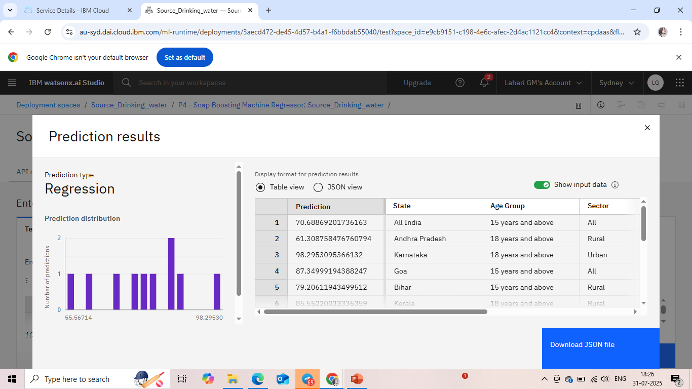
Result

Slide 8
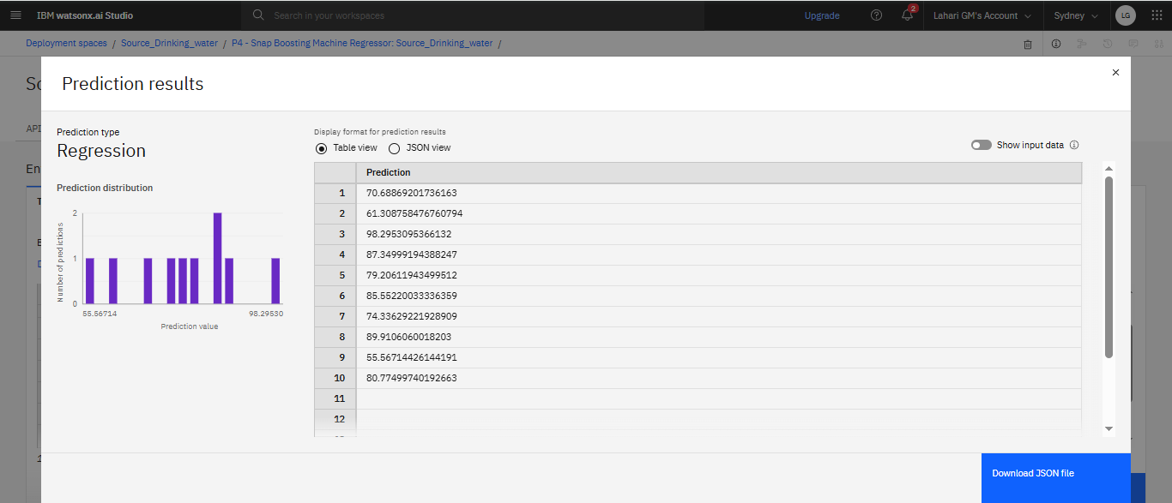

Slide 9
Conclusion
This study revealed significant disparities in access to improved drinking water sources, especially in rural and economically weaker regions.
Using IBM Cloud tools ensured reliable data handling and insightful visualization. These findings can aid stakeholders in addressing water accessibility gaps and achieving SDG goals.

Slide 10
Future scope
Include data from future MIS rounds for trend analysis
Integrate real-time monitoring data (IoT sensors, remote sensing)
Expand to other SDG-related indicators like sanitation
Collaborate with local governments for field validation

Slide 11
References
Multiple Indicator Survey (78th Round) – AI Kosh Dataset
Sustainable Development Goals (SDG 6) – UN Data
IBM Cloud Documentation
Python for data analysis

Slide 12
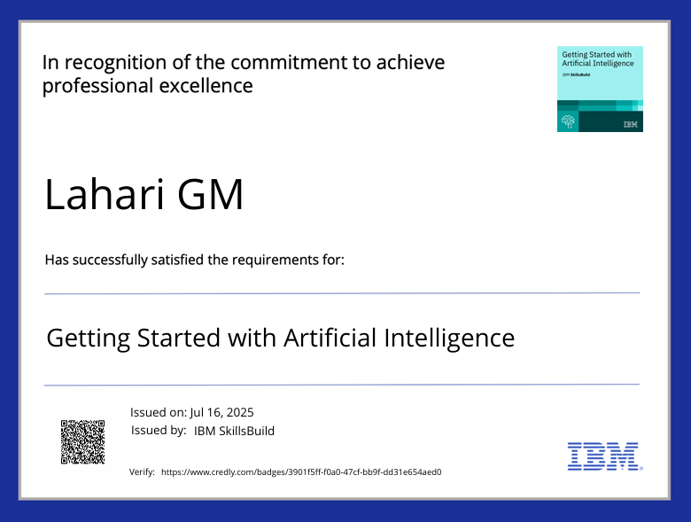
IBM Certifications

Slide 13
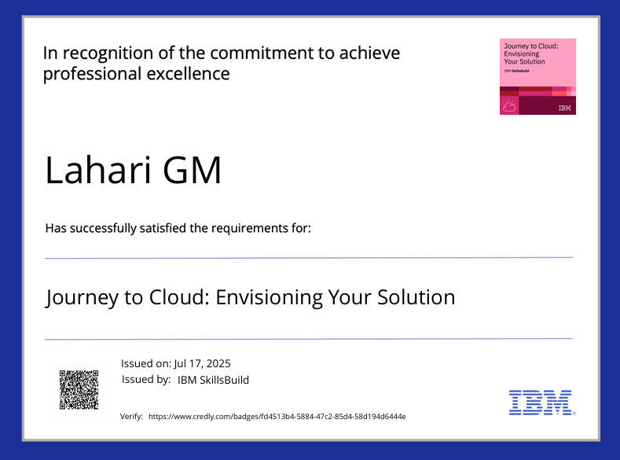
IBM Certifications

Slide 14
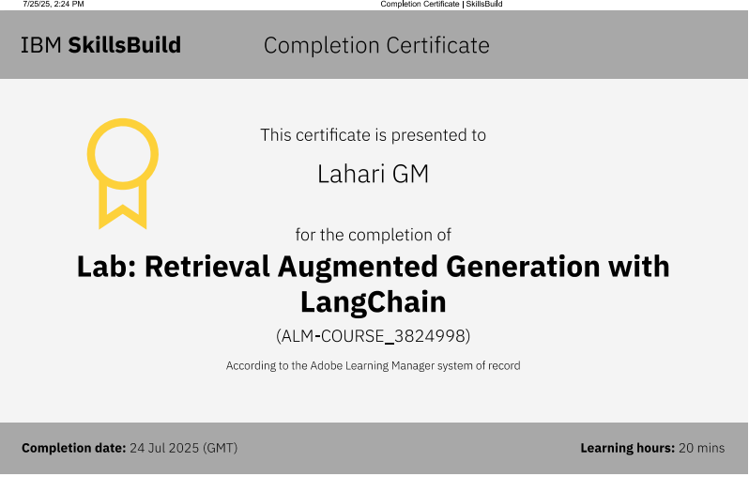
IBM Certifications

Slide 15
THANK YOU
GITHUB REPOSITORY LINK :
https://github.com/Lahari-2408/IBM_pdf.git

